Slide 1


Sprint Planning
Jewelry
Project
1

Slide 2
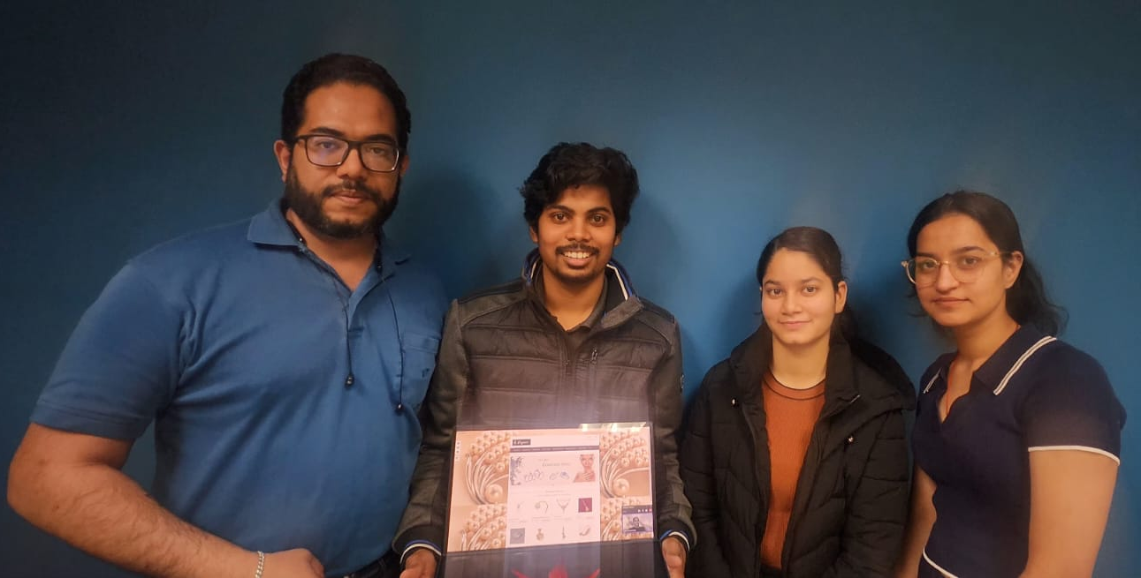
Team & Logo
Team Members
2

Slide 3
Aims and Features
Explore a diverse selection of metals and gemstones available on our platform.
Gems & Metals
Rental Jewerly
Our main impetus to carry out this project lies in our desire to empower people to create unforgettable and meaningful memories that they can treasure forever. We strongly believe in the importance of capturing special moments and transforming them into unique and personalized jewelry.
Zodiac
Rate Tracker
Access comprehensive details and high-quality photos for each metal and gemstone.
Our Aim
What are we look for?
We are inspired by the idea that each piece is not just an ornament, but a treasure loaded with emotions and meaning, becoming a tangible reminder of happy moments, important achievements or loved ones. We are committed to offering our customers the opportunity to celebrate and share their most cherished experiences in a truly special and lasting way.
Design
Our Aim
Quality
Elegance
Feeling
Make your jewelry
Memories and Joy

Slide 4

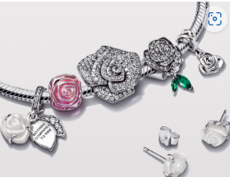
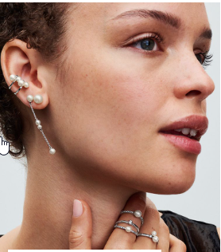
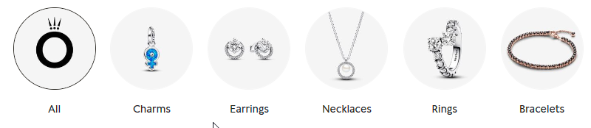
List of features
Our slogan is: Your dream is your jewel..
Collections and Designs
Custom, Crafts & Zodiac
Rental Service
Access a curated selection of sophisticated jewelry pieces, exuding glamour and style, through this option.
Rental
Enjoy a seamless and luxurious experience
Occasion Filters
Elevate your Style
Personalization Options
Learn about the distinctive qualities, cultural symbolism, and historical significance of each material.
Explore a diverse range of elegant designs, including classic, modern, and contemporary styles, tailored to various tastes and preferences.
Personalized Creations: Users can design custom jewelry.
Crafted to Perfection: Each customized item is meticulously handcrafted by skilled artisans to ensure the highest quality and attention to detail.
Zodiac Inspired Designs: Explore a range of jewelry designs inspired by zodiac signs, allowing users to celebrate their astrological identity.
Passport Requeriment
Make informed decisions when selecting materials for personalized jewelry pieces.
Special Offers
Ensure that each creation reflects individual tastes and style preferences.
Our charms are worn with love on bracelets and necklaces; created especially to be worn in ways unique to those who wear them.

Slide 5
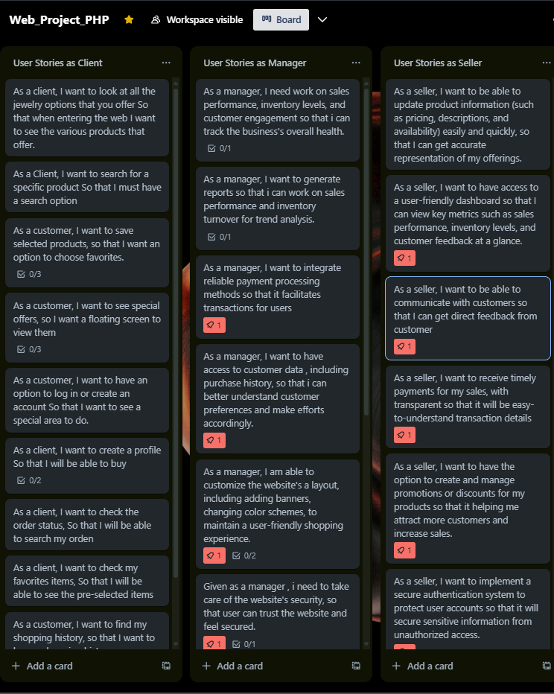
List of prioritized User Stories
1. As a Client, I want to easily navigate through the website to discover different categories of jewelry (rings, bracelets, necklaces, etc.) to find the product that best suits my tastes and needs.
2. As a customer, I want to be able to customize jewelry by selecting different materials, gemstones, and engravings to create a unique and meaningful piece.
3. As a Client, I want to view detailed images and complete descriptions of each product to assess its quality and design before making a purchase.
4. As a Client, I want to track the status of my order, including processing, shipping, and delivery, to stay informed about the estimated arrival date of my jewelry.
5. As a customer, I want to leave feedback and ratings on the products I have purchased to help other customers in their decision-making process.
As a Client
As a Manager
As a Seller
Notes:
To carry out our work we have made using the Trello System approximately 40 user stories of which we have ranked them and giving them the importance about how we should realize the desired Project having as main user histories the following that can be seen as user.
We found that the Project Development is classified into 3 types of users: the client, the administrator and the seller, prioritizing these stories we managed to make our Sprint Goal and our distribution of tasks that we will see later

Slide 6
List of prioritized User Stories
1. As a manager, I want to easily manage the inventory of products, including adding new products, updating stock levels, and removing sold-out products.
2. As a manager, I want to access sales reports and data analysis to understand market trends and make informed decisions about marketing strategies and stock.
3. As a manager, I want to manage customer orders, including tracking order status and handling returns and refunds if necessary.
4. As a manager, I want to set up and manage promotions and discounts in the online store to attract new customers and retain existing ones.
5. As a manager, I want to manage user profiles and system access permissions to ensure the security and privacy of customer data.
As a Client
As a Manager
As a Seller
Notes:
To carry out our work we have made using the Trello System approximately 40 stories of which we have ranked them and giving them the importance about how we should realize the desired Project having as main user histories the following that can be seen as clients, manager and seller.
We found that the Project Development is classified into 3 types of users: the client, the administrator and the seller, prioritizing these stories we managed to make our Sprint Goal and our distribution of tasks that we will see later

Slide 7
List of prioritized User Stories
1. As a seller, I want to view a summary of available products and their details, including prices and stock levels, to provide accurate information to customers during sales inquiries.
2. As a seller, I want to create customized quotes for customers who want unique or personalized pieces, including options for materials and pricing.
3. As a seller, I want to track customer inquiries and requests, including follow-up orders and returns tracking, to provide efficient and satisfactory customer service.
4. As a seller, I want to access internal communication tools to collaborate with other team members, share important information, and resolve issues effectively.
5. As a seller, I want to access training resources and marketing materials to improve my sales skills and effectively promote store products
As a Client
As a Manager
As a Seller
Notes:
To carry out our work we have made using the Trello System approximately 40 stories of which we have ranked them and giving them the importance about how we should realize the desired Project having as main user histories the following that can be seen as clients, manager and seller.
We found that the Project Development is classified into 3 types of users: the client, the administrator and the seller, prioritizing these stories we managed to make our Sprint Goal and our distribution of tasks that we will see later

Slide 8
Sprint Goal
AREA OF Focus
Develop
Enhanced User Experience: Implement features to provide a seamless and personalized shopping experience for customers.
Expanded Service Offerings: Introduce new services such as customizable jewelry, rental options, and maintenance programs.
Improved customer engagement and satisfaction.
Increased customer retention and loyalty.
Expansion of customer base through enhanced service offerings.
Competitive advantage in the online jewelry market.
Aim
Application
Design and Construction
Elaborate Spring Planning
To improve the 'Elegance' online jewelry store platform by enhancing user
experience and expanding service offerings to increase customer satisfaction
and retention.
Testing
Design
Definition Story History
Application
Construction
AGILE
DEVELOPMENT
Define
Requirements
Expected Outcome
Evaluation and Monitoring
Expected
Outcome
Delivery of the Final Product
Deploy and Review

Slide 9
Sprint Goal
PROJECT STATUS
MEETING SPECIFICS
Product/Project Component | Not Yet | To Do | In Progress (% of completion) | Done | We have an Issue!
Business Case |  |  |  | OK
Product Vision & Box |  |  |  | OK
User Stories Workshop (story and acceptance criteria) |  |  |  | OK
Estimation Planning & Moscow Prioritization |  |  |  | OK
TRELLO – final setup |  |  |  | OK
Sprint Planning (Potential breakdown of user stories into requirements and/or tasks) |  |  |  | OK
Design Mock-up |  |  |  | Ok
Web Development |  |  | 95% |  | Problems with css and connecting Database Url Zodiac Jewellery
Retrospective |  |  | 99%
Building Presentation Slides |  |  |  | OK
Dry Runs (practice presentation) |  |  |  | OK
Meeting # | Date | Platform | Time | Duration
1 | 2024-02-23 | Presential | 15:30 – 17:00 | 1 hr. 30 min
2 | 2024-03-02 | Meet | 18:00 – 20:00 | 2 hr. 00 min.
3 | 2024-03-09 | Meet | 18:00 – 20:00 | 2 hr. 00 min.
4 | 2024-03-16 | Meet | 18:00 – 20:00 | 2 hr. 00 min.
5 | 2024-03-23 | Meet | 18:00 – 20:00 | 2 hr. 00 min.
6 | 2024-03-30 | Meet | 18:00 – 20:00 | 2 hr. 00 min.
7 | 2024-04-06 | Meet | 18:00 – 20:00 | 2 hr. 00 min.
8 | 2024-04-13 | Meet | 18:00 – 20:00 | 2 hr. 00 min.
9 | 2024-04-20 | Meet | 18:00 – 20:00 | 2 hr. 00 min.
10 | 2024-04-27 | Meet | 18:00 – 20:00 | 2 hr. 00 min.
11 | 2024-04-29 | Presential | 10:00 – 12:00 | 2 hr. 00 min.
All members of the group work in the various activities achieving the goal
Scrum
Master

Slide 10
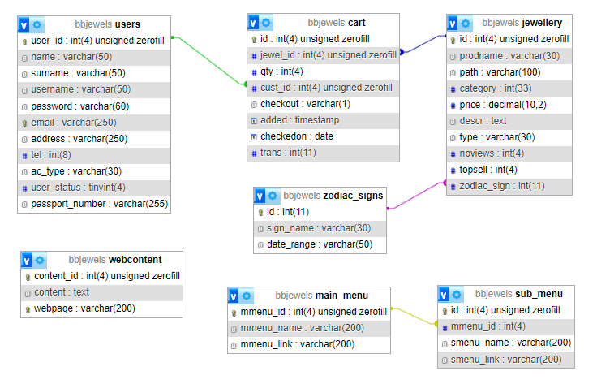
Database Design

Slide 11
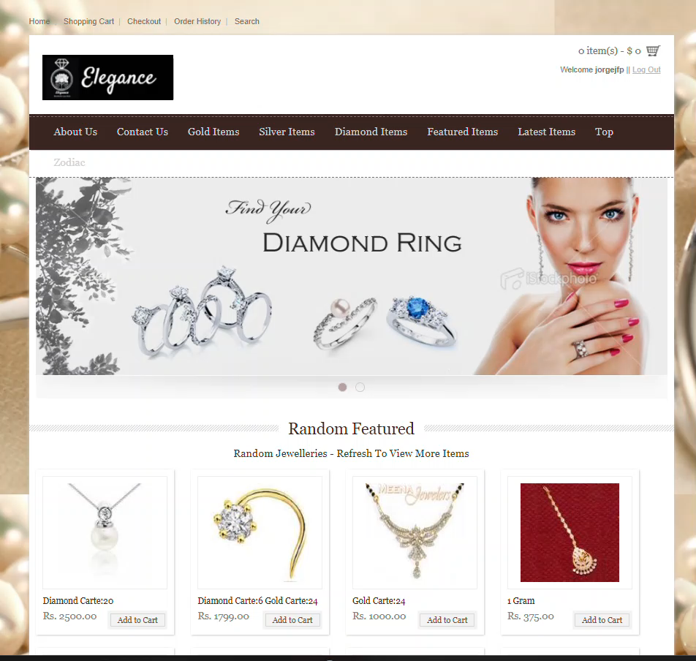
UI Design

Slide 12
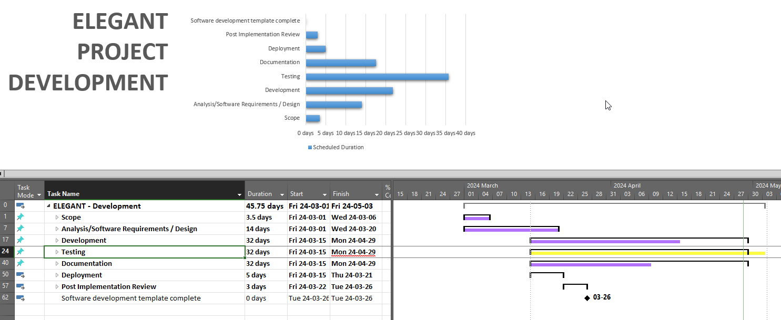
Distribution Tasks
Notes:
In the distribution of tasks performed using Microsoft Project We can see how tasks and estimated times will be distributed.
Being all about presenting

Slide 13
Distribution Tasks
Notes:
In the distribution of tasks performed using Microsoft Project We can see how tasks and estimated times will be distributed.
Being all about presenting

Slide 14


